Slide 1
DATA ANALYTICS
The “Monthly insights data” provides the sales details of various products sold out by different retailers for two consecutive years. This data will helps to get better idea about the selling trends of various products thus helps to identify the sales performance of various brands & retailers. We could be able to find out the Selling trends of individual products by comparing category wise sales. Also sales performance of the retailers can be understood by comparing retailer wise sales comparison.

Slide 2
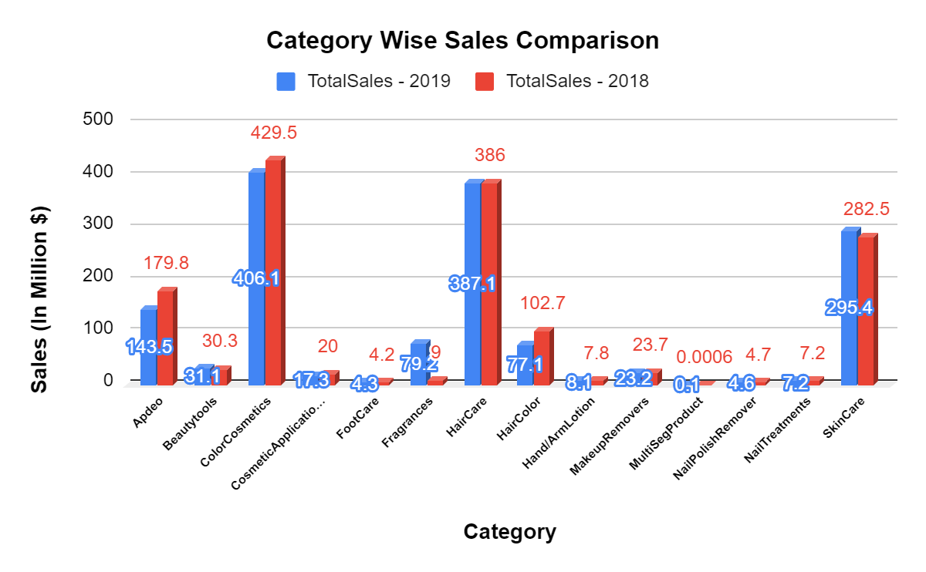
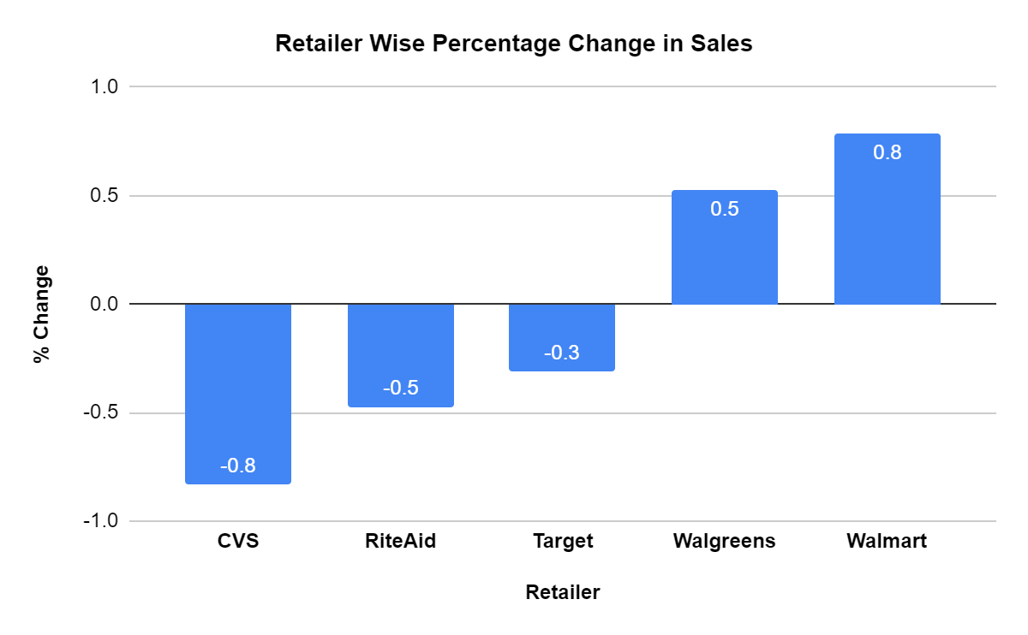
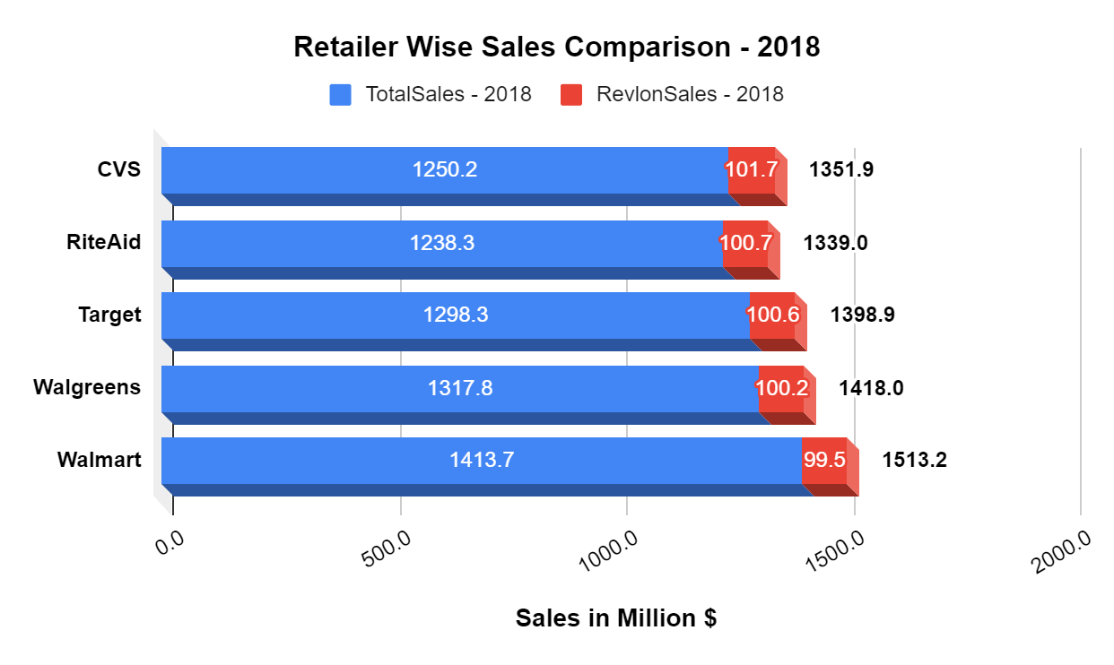
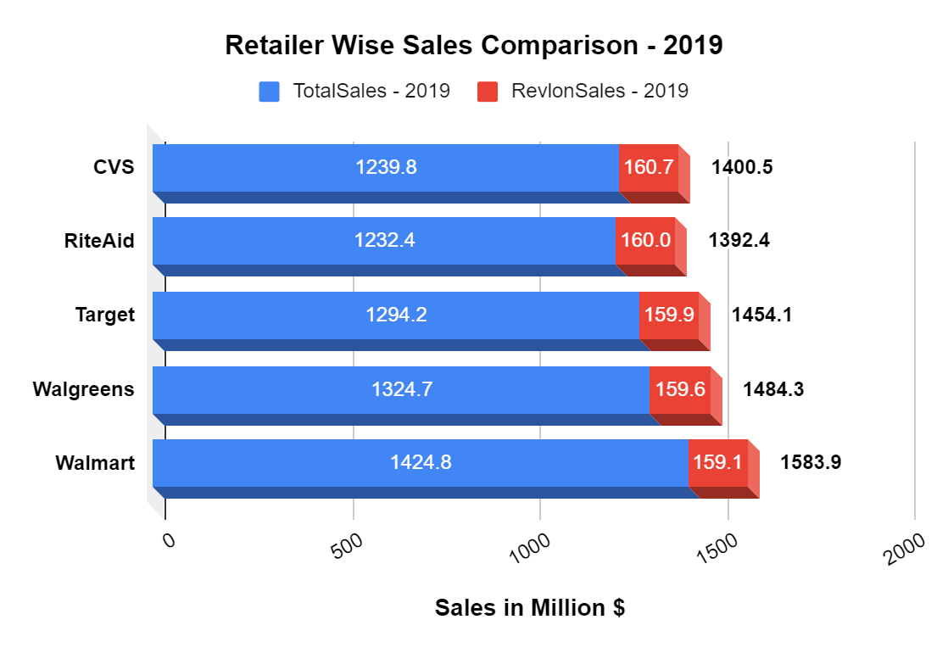

Slide 3
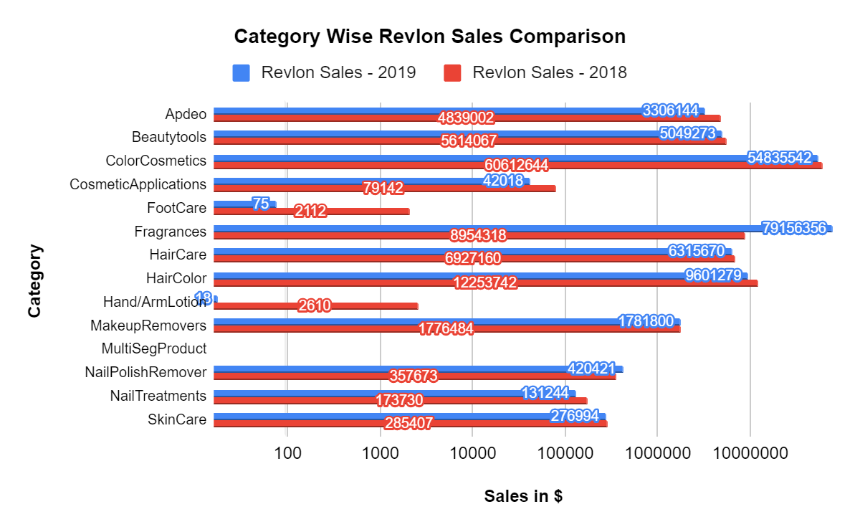
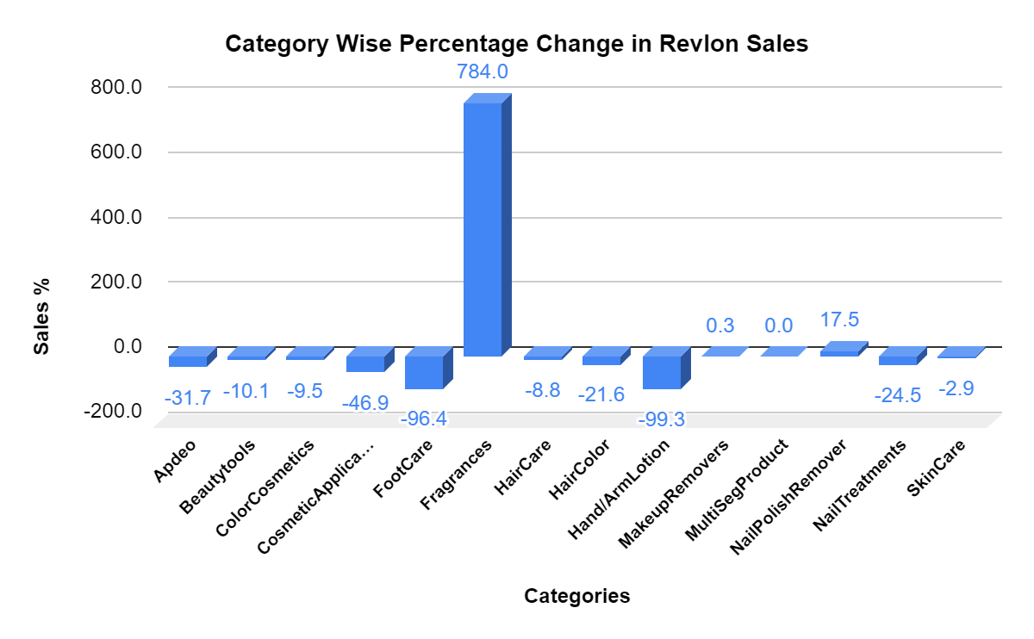
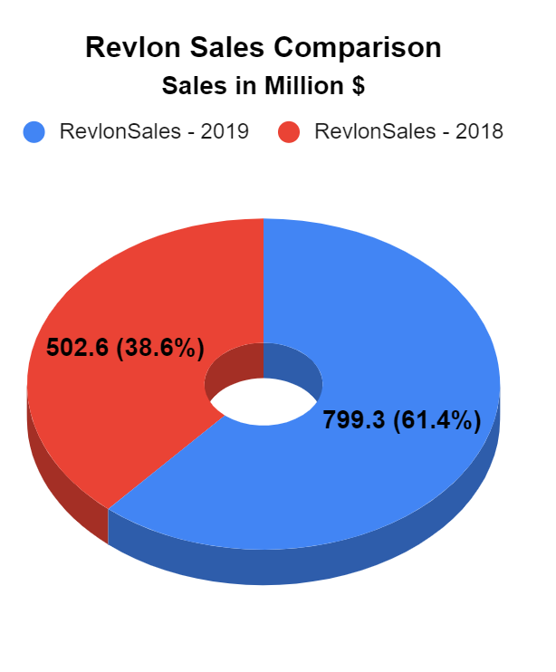

Slide 4
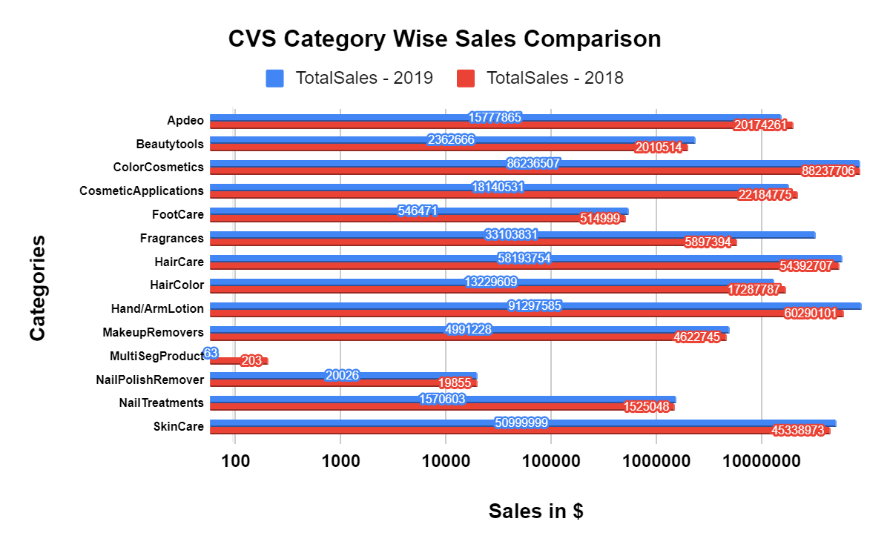
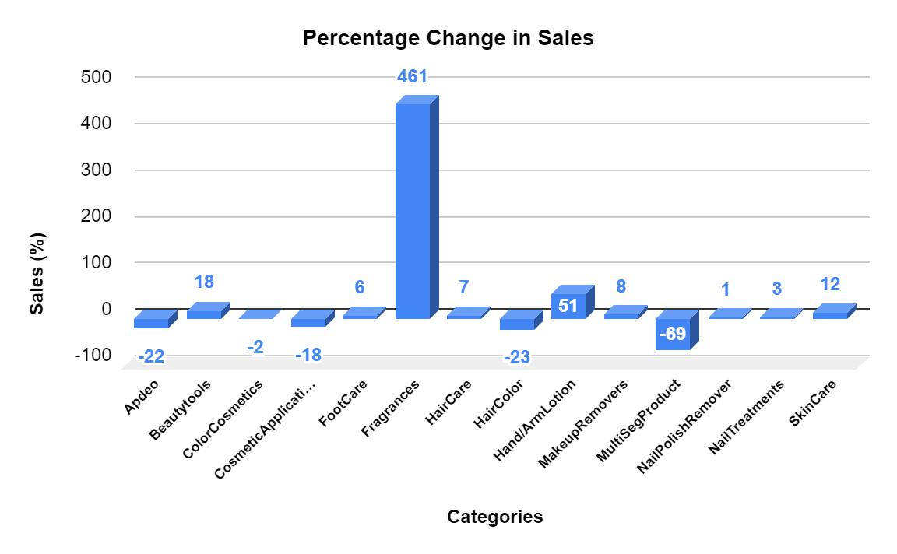

Slide 5
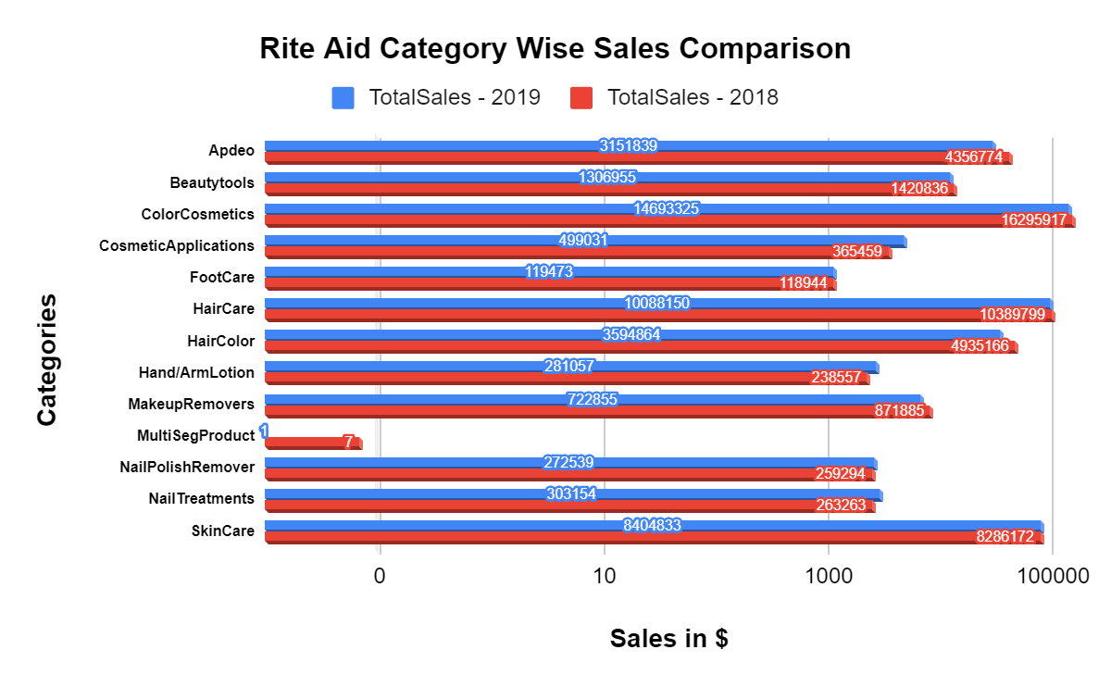
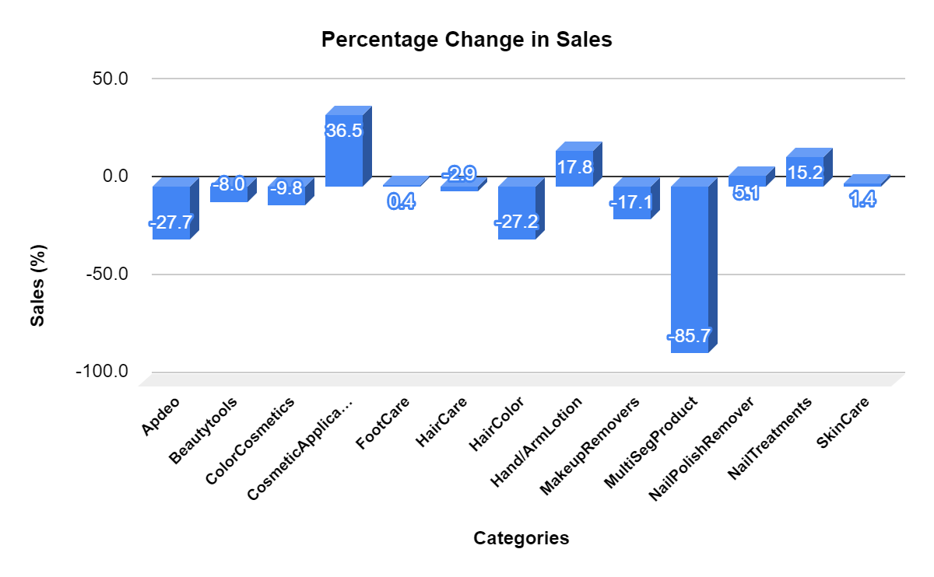

Slide 6
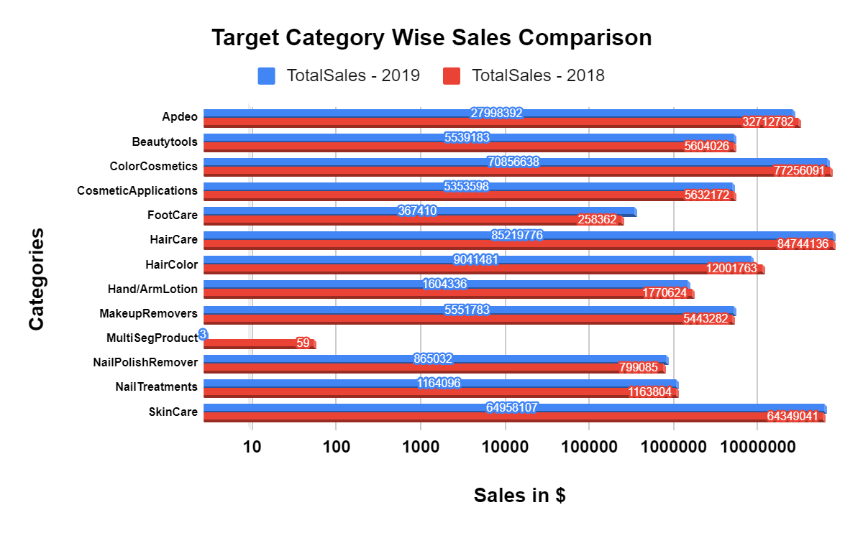
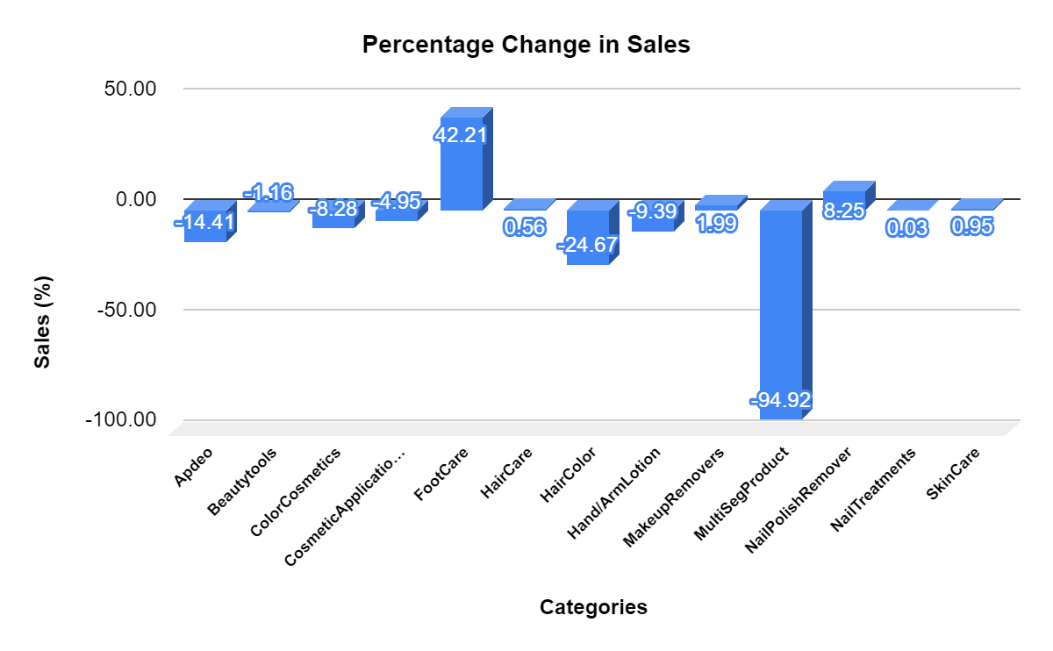

Slide 7
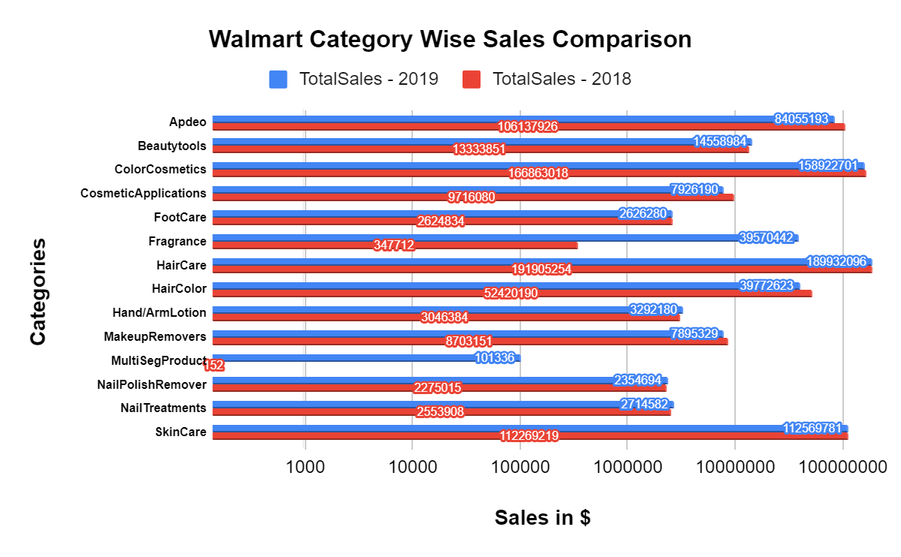
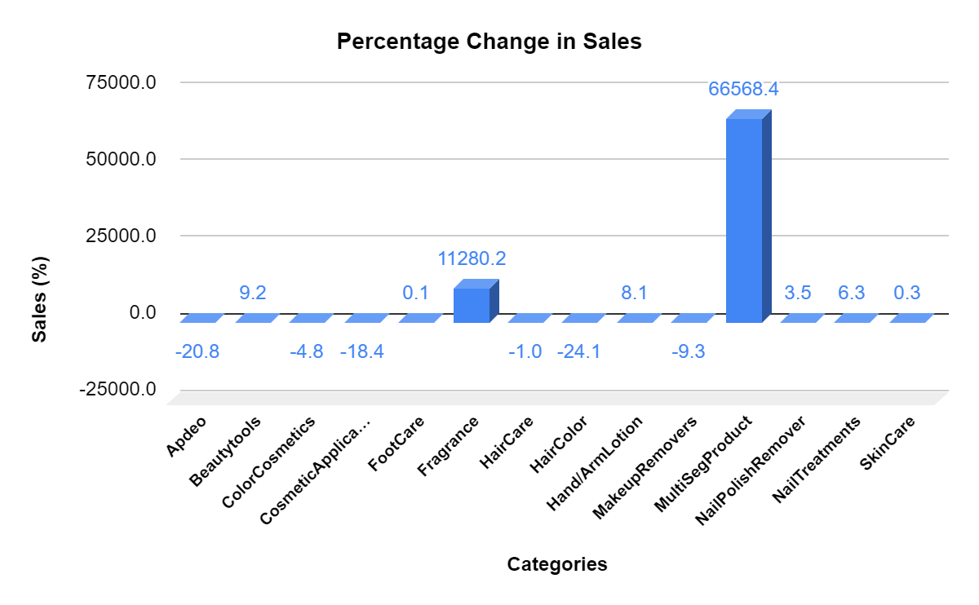

Slide 8
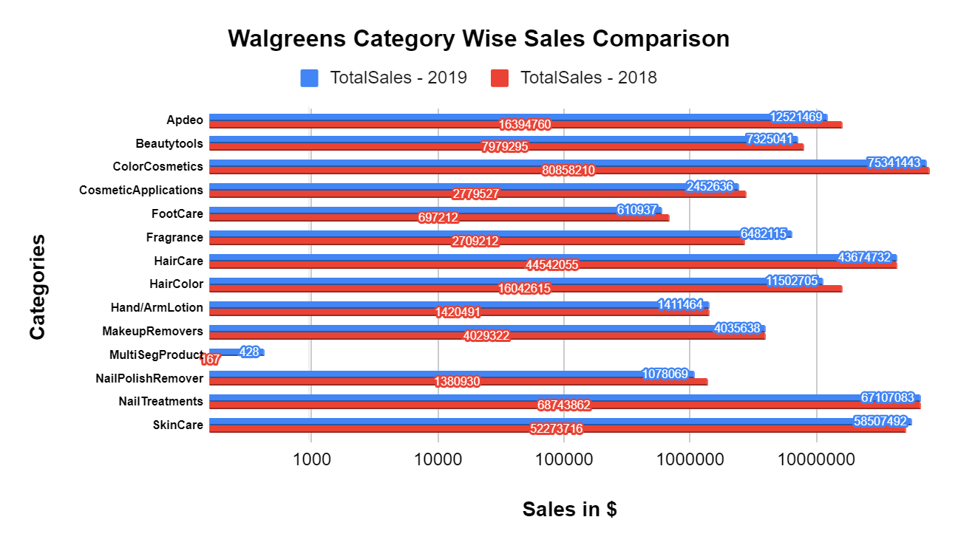
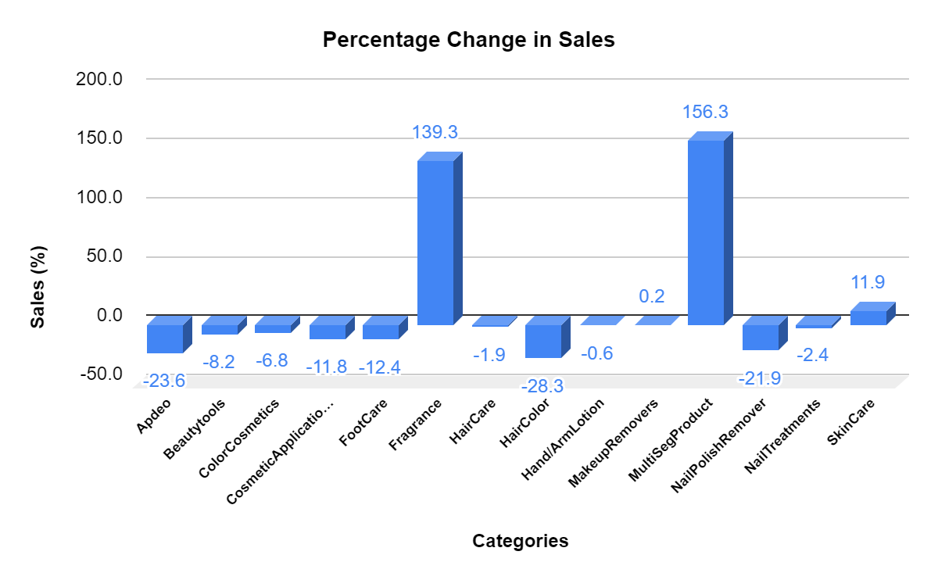

Slide 9
The “Brand sales data” provides the sales details of each category of products with their selling brands and their sales in descending order of sales performance. This data will help to evaluate the brand’s sales performance for each category of products. Consecutive year sales details help to assess and compare the selling trends of each brands. From the category sales comparison graph it has been noticed that most category items shows prominent sales growth when compared to previous year.

Slide 10
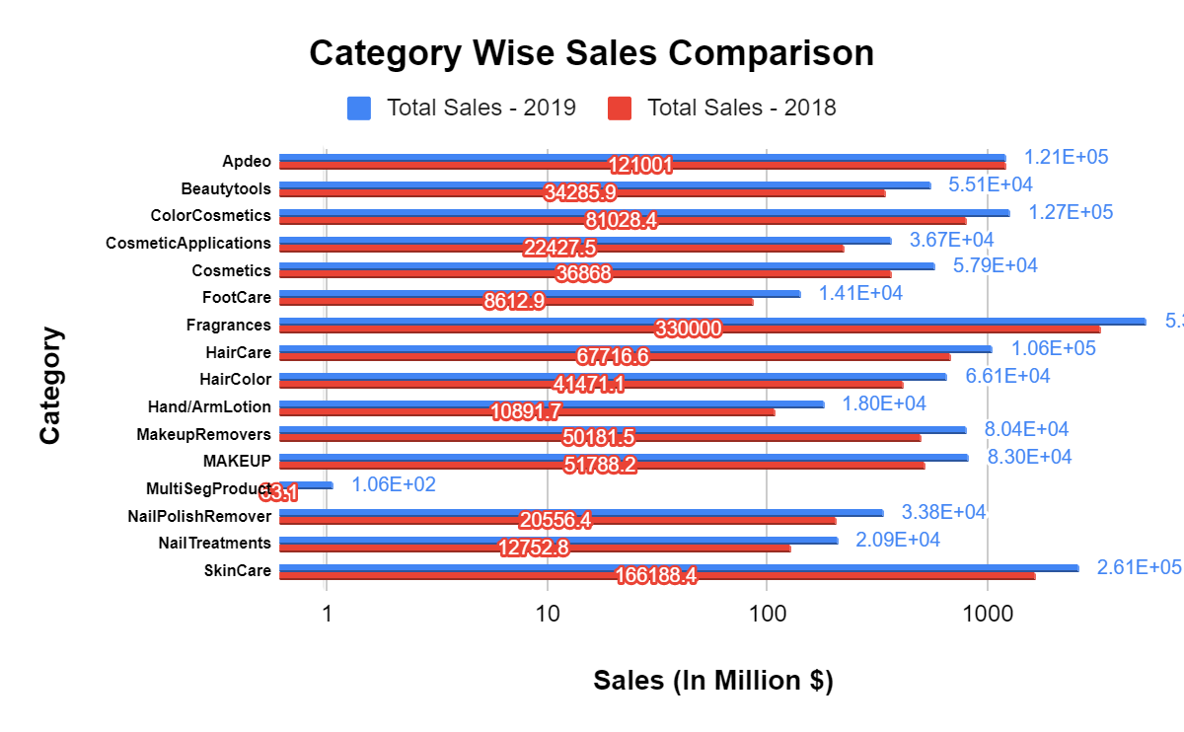
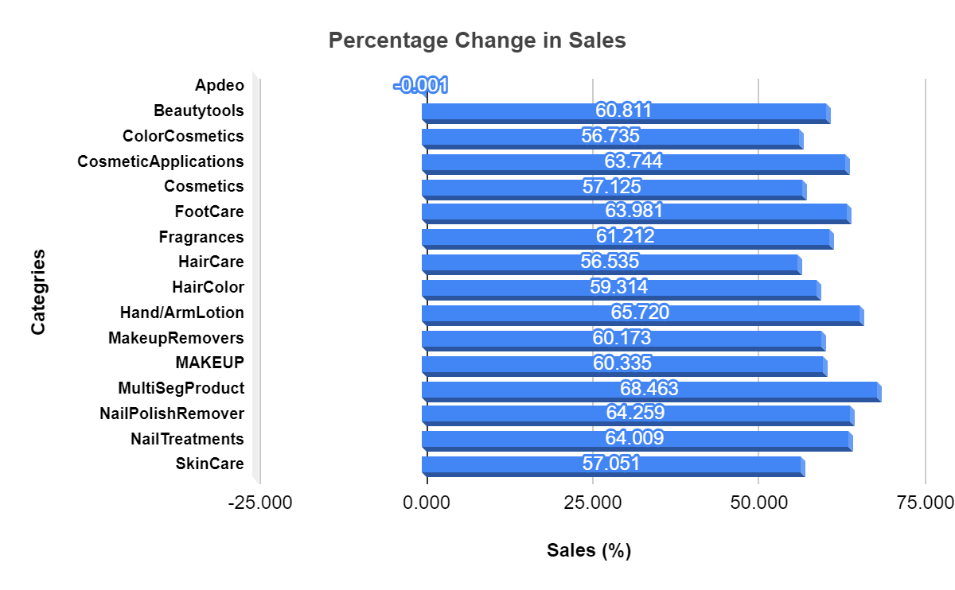
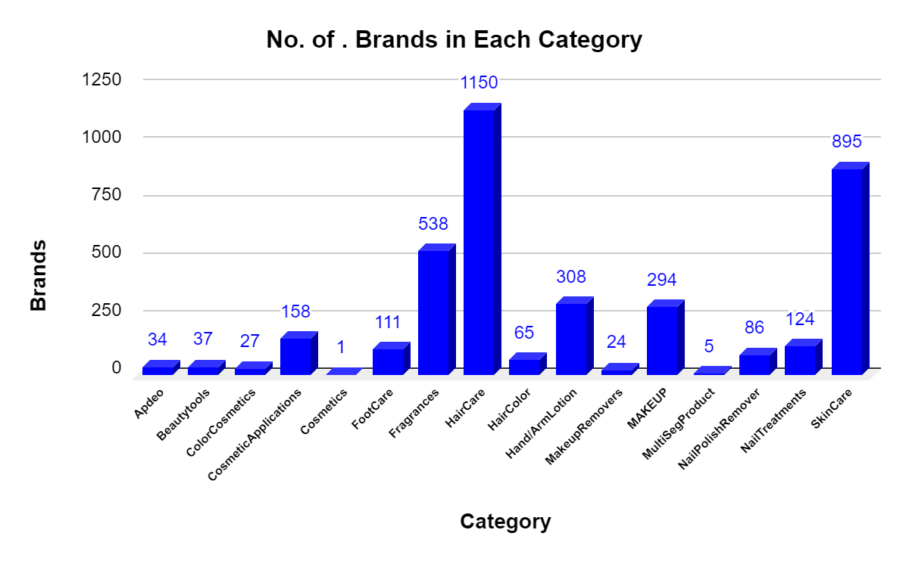
5.3E+05

